Slide 1

LAB – 3 Modulation Waveforms
Goals: The purpose of this lab is to use the HP 33120A Function Generator to generate ASK, FSK, AM, and FM Waveform.
You will also observe the spectrum of these signals.

Slide 2
COMPONENTS REQUIRED :
NI MULTISM 14.2
Amplitude Modulation :
Oscilloscope,
AC Power (2)
Multiplier
Spectrum Analyzer
Resistors (3)
Amplitude Shift Key :
Function Generator (2)
Four Channel Oscilloscope
Resistors (3)
Digital Grounds
BC107BP

Slide 3
Frequency Shift Key
Oscilloscope,
Function Generator
NOT gate
Resistors (5)
capacitors (2)
LM555CM
GROUND (2)
VCC
BC558AP

Slide 4
MODULATION :
Modulation is the process of altering one or more properties of a periodic waveform known as a carrier signal to transfer information.
Modulation is performed by the device known as a modulator.
This technique is mainly used to overcome the interference of the signal.
This techniques typically aid in long-distance communication.
Modulation is of two types:
1) Analog Modulation
Amplitude modulation (AM)
Frequency modulation (FM)
Phase modulation (PM)
2) Digital modulation
Amplitude shift keying (ASK)
Frequency shift keying (FSK)
Phase Shift keying (PSK)

Slide 5
What is the need for modulation?
We live in a digitally advanced era where the need for wires is no longer a necessity to be connected to everyone. Messages, information and signals are sent from one part of the world to another within minutes.
The process of modulation plays a major role in the fast transmission of signals.
Below, we have mentioned a few of its importance in the communication system:
1) Size of the Antennae λ --- wave length
λ = c/f C --- speed of light
f --- signal frequency
2) Reduce interference

Slide 6
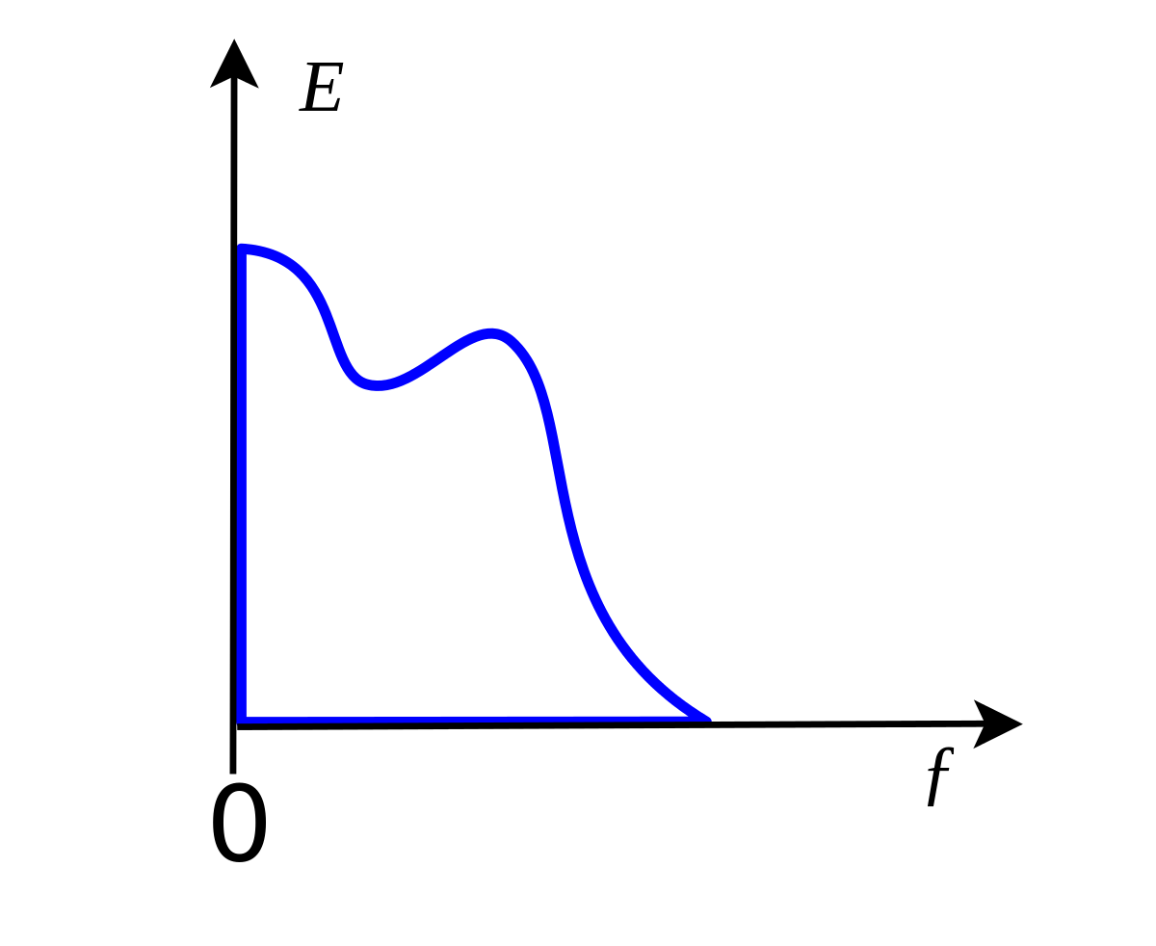
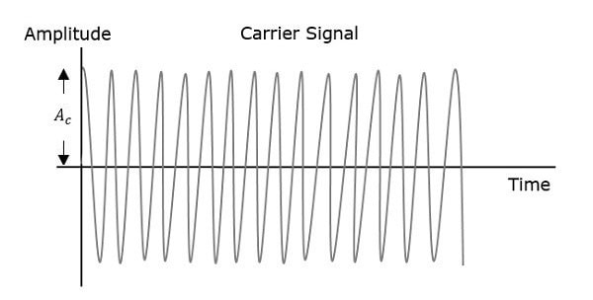
Baseband Signal : The baseband signal is nothing but the original message signal that the user wants to transmit which is unconverted or we can say unmodulated.
Carrier Signal : High frequency periodic signal, which carries baseband signal is known as the carrier signal.

Slide 7
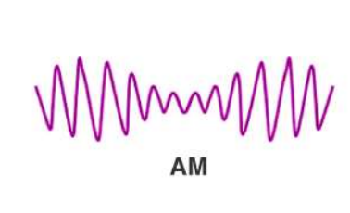
Amplitude Modulation :
Amplitude modulation is a modulation technique where the amplitude of a carrier varies depending on the information signal.
AM radio broadcast signals use lower carrier frequencies, this helps them to travel long distances.
The distance traveled by the AM is much larger than the FM.

Slide 8
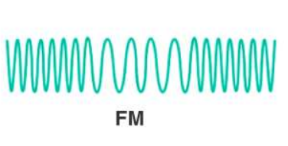
Frequency Modulation
In this module, the frequency of the carrier wave is modified according to the signal that carries information.
The radio signals have large bandwidth than AM radio signals, which helps to offer much better sound quality.

Slide 9
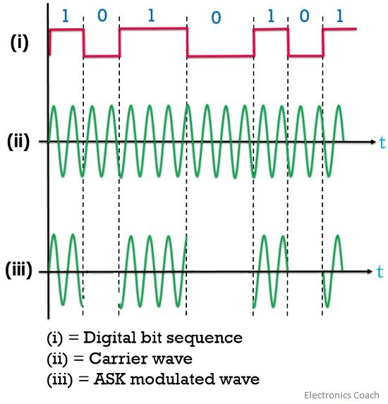
AMPLITUDE SHIFT KEY
Amplitude Shift Keying is a type of Amplitude Modulation which represents the binary data in the form of variations in the amplitude of a signal.
Any modulated signal has a high frequency carrier. The binary signal when ASK modulated, gives a zero value for Low input while it gives the carrier output for High input.

Slide 10
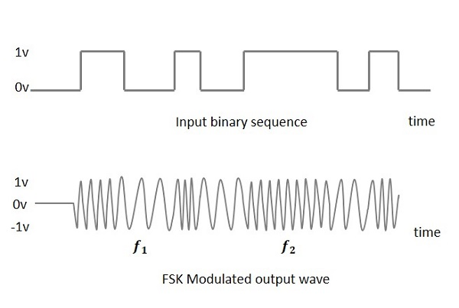
FREQUENCY SHIFT KEY
Frequency Shift Keying is the digital modulation technique in which the frequency of the carrier signal varies according to the digital signal.
The output of a FSK modulated wave is high in frequency for a binary High input and is low in frequency for a binary Low input.

Slide 11
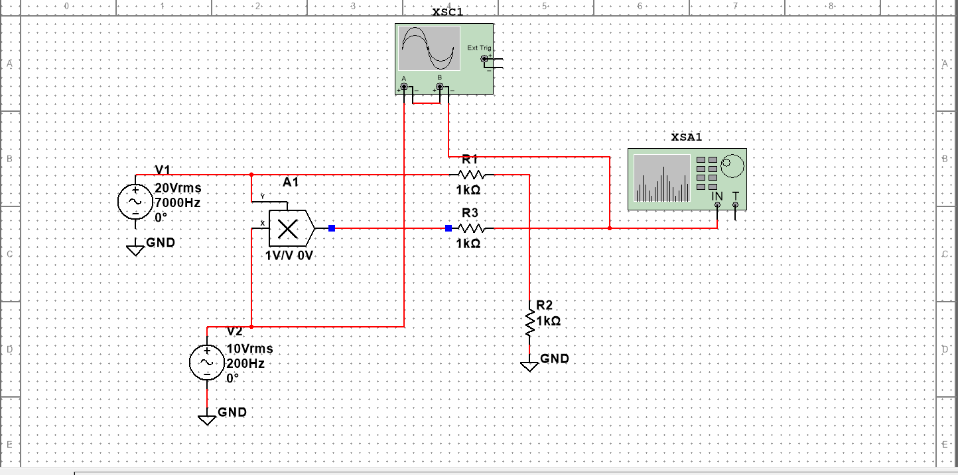
AMPLITUDE MODULATION :

Slide 12
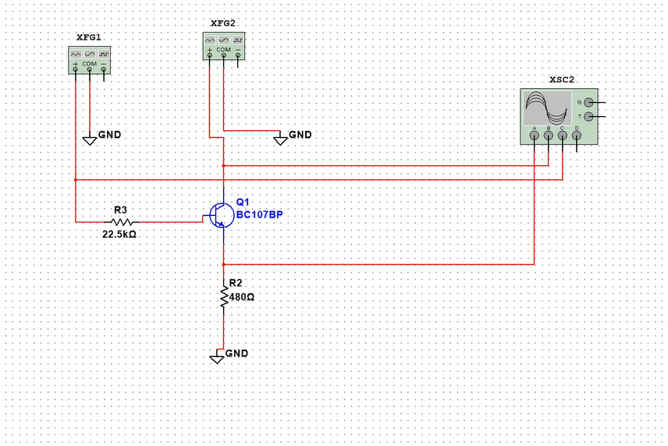
AMPLITUDE SHIFT KEYING

Slide 13
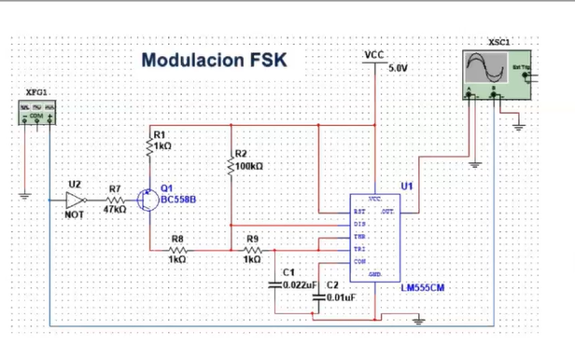
FREQUENCY SHIFT KEYING

Slide 14
THANK YOU

